Slide 1


Short-time quantum Fourier transform processing ICASSP 2025 (Hyderabad, India)
Presenter : SREERAJ RAJINDRAN Nair (uts, Dolby Intern)
Co-authors : BENjamin SOUTHWELL (Dolby), CHRISTOPHER FERRIE (UTS)

Slide 2
Project summary
Proposal: To employ Quantum windowing in conjunction with quantum adapted version of classical signal reconstruction algorithm and demonstrate quantum speedup/advantage (if any). Benchmark traditional windowing functions in QWFT.
Motivation: Successful use of Quantum algorithms for signal processing will require this reconstruction algorithm. Rolling codec in conjunction with Quantum algorithms will need this as a subroutine.
Novelty: Quantum windowing is a relatively less developed aspect of Quantum signal processing. It is crucial to bridge this gap in research. Reconstruction has never been attempted with QWFT.

Slide 3
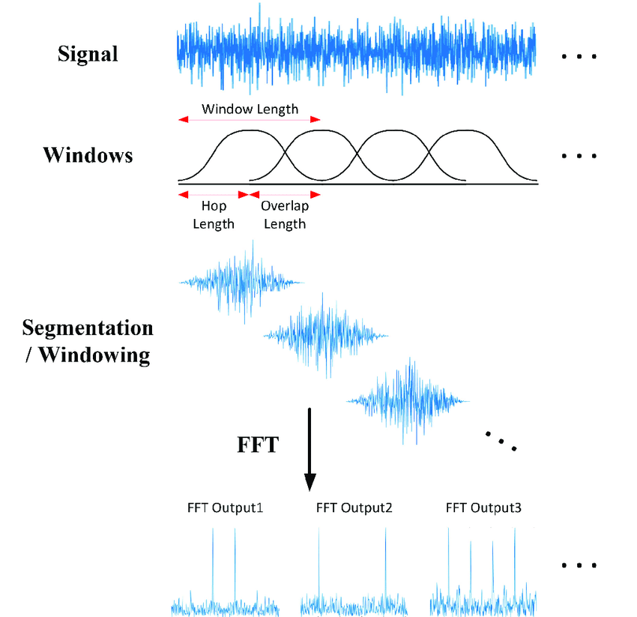
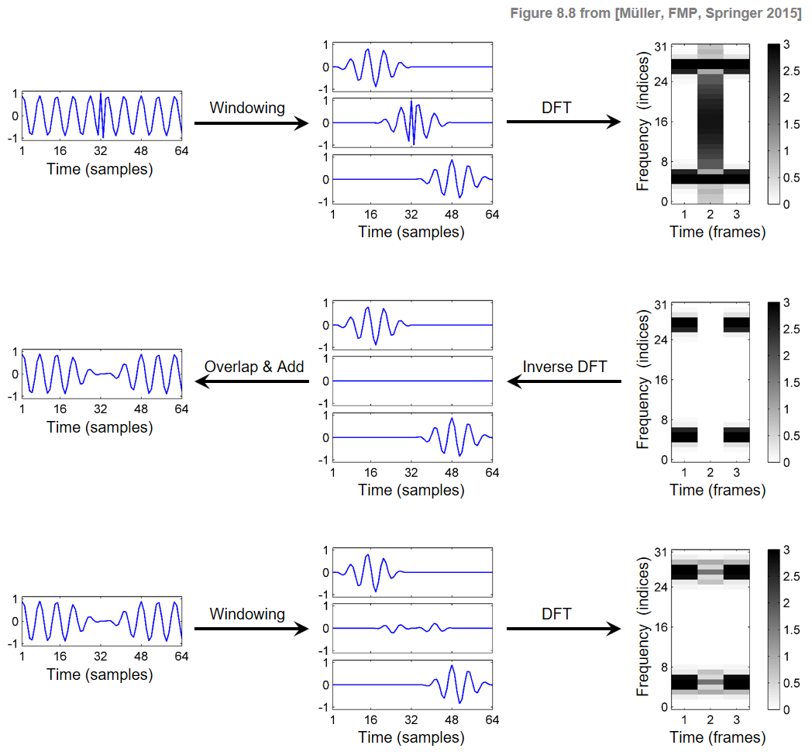
STFT
OBJECTIVE: Adapt Classical Reconstruction framework to Quantum domain
Reconstruction algorithm

Slide 4

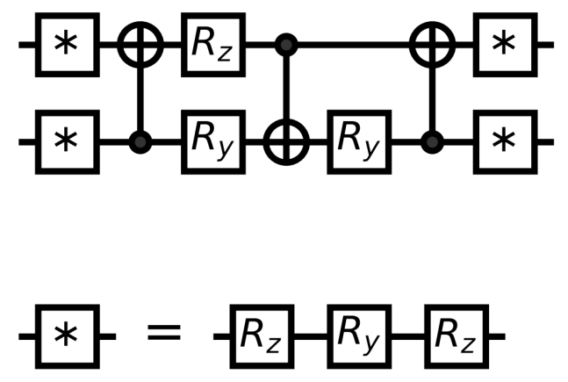
QWFT (mod)
Quantum Reconstruction algorithm
Simulations
+
Real Hardware
Proposed framework for the project

Slide 5
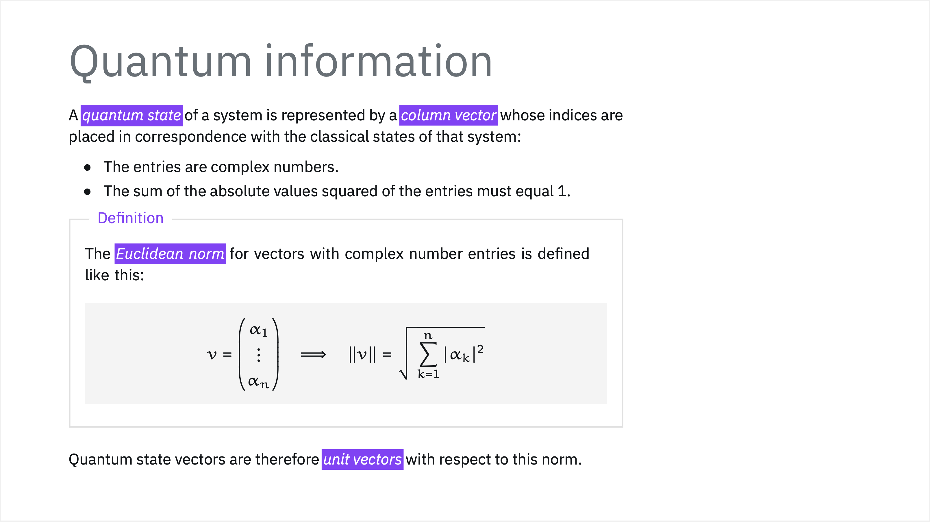
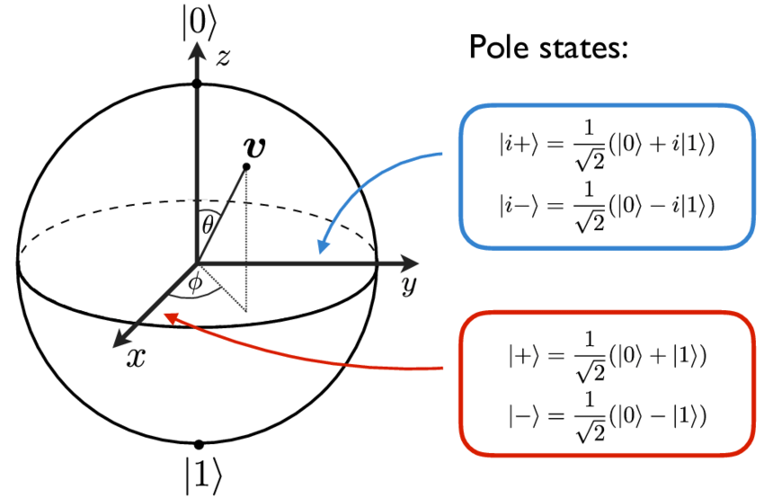
Amplitude encoding:

Slide 6
Amplitude encoding:

Slide 7
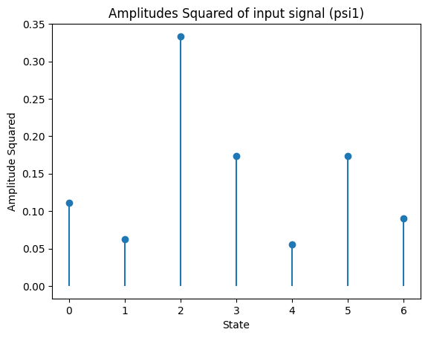
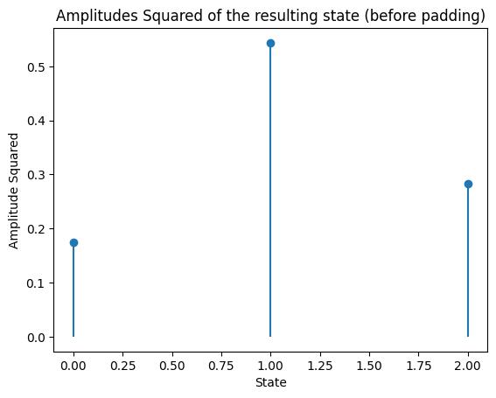
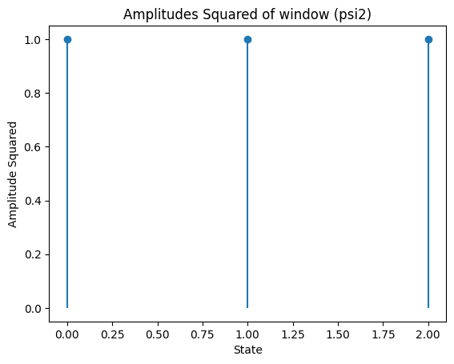
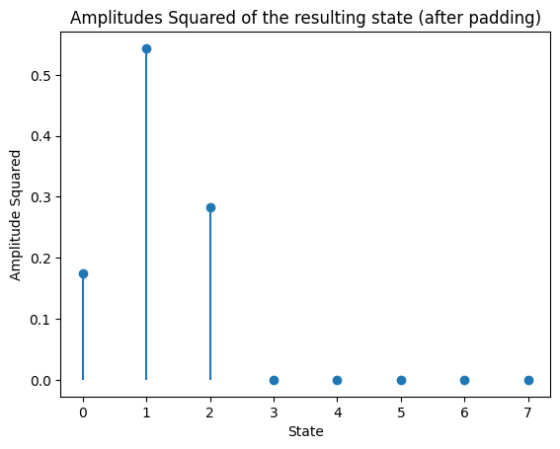
Quantum Window State preparation:
1.
Element wise product and L2 Normalisation
2.
TODO: TRACK WINDOW NORM
Classical
Preprocessing
Padding to the power of 2 over
(N + M -1)
Rectangular Window
N = 3
3.
Quantum
Processing
Amplitude Encoding
|Psi> = a|000> + b|001> + c|010> +d|011> + e|100> +f|101> +g|110> + h|111>

Slide 8
SUBROUTINE 1:
FILTER AS A QUANTUM REGISTER

Slide 9
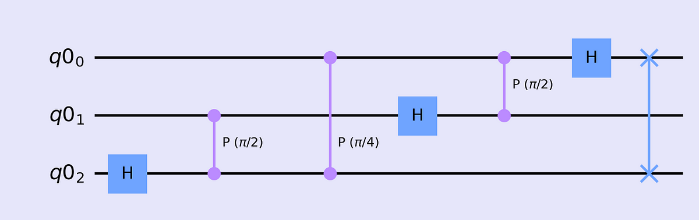
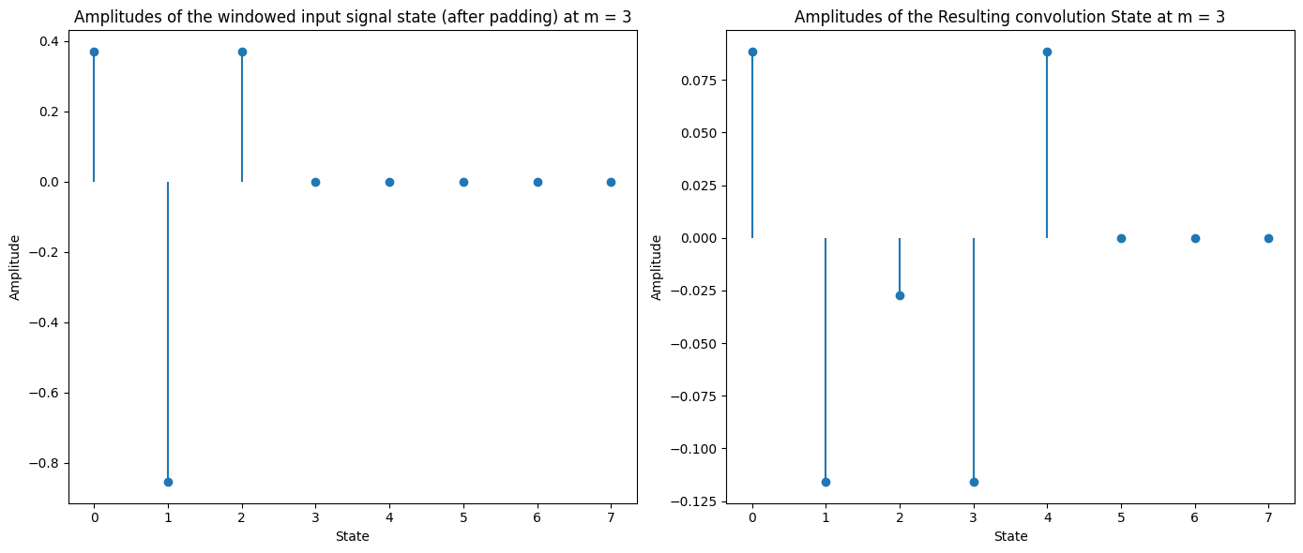
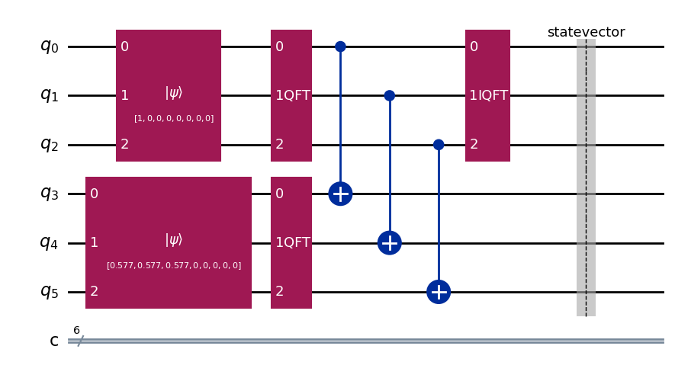
WINDOWED STATE
Subroutine 1: Quantum Convolution algorithm: Filter as a Quantum Register
QFT
I/P: WINDOWED SIGNAL
O/P: CONVOLUTION
ELEMENT WISE PRODUCT
TODO:
RECTIFY WINDOW NORM
and
FILTER NORM
Box car filter / Avg filter. N = 3
TODO: TRACK FILTER NORM
FILTER
# For N qubit window register we need N ancillas to handle filter encoding. So 2N qubits in total.

Slide 10
WINDOWED STATE
Quantum Reconstruction algorithm: Classical Overlap-Add
OVERLAP ADD
ELEMENT WISE PRODUCT
FILTER
QFT
Classical
Post-processing

Slide 11
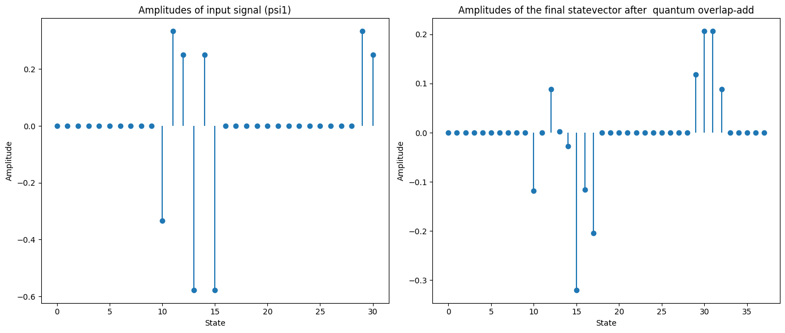
Quantum Reconstruction algorithm output:
What about Zeroes state ?
What about Negative amplitudes ?
Box car filter / Avg filter
N = 3

Slide 12
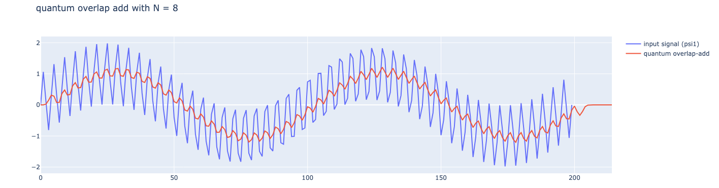
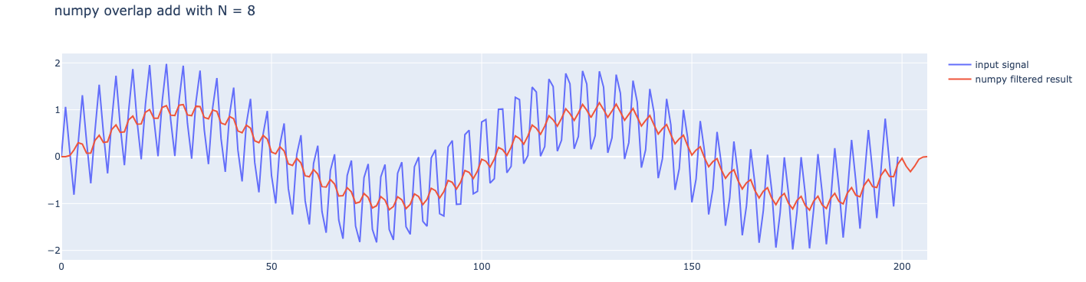
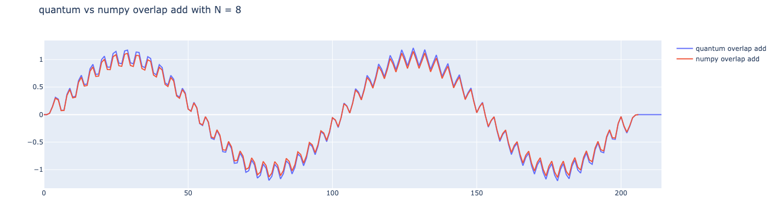
SINC FILTER (N = 8)
# Implemented with Qiskit

Slide 13
SUBROUTINE 2:
FILTER AS A UNITARY GATE

Slide 14
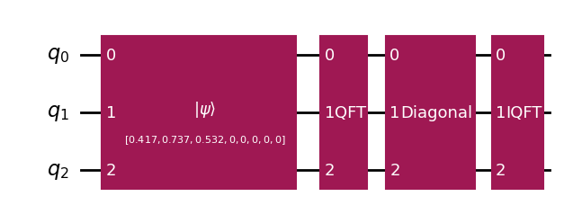
Subroutine 2: Quantum Convolution algorithm: Filter as a Unitary Gate
QFT
I/P: WINDOWED SIGNAL
O/P: CONVOLUTION
WINDOWED STATE
FILTER
ANCILLA

Slide 15
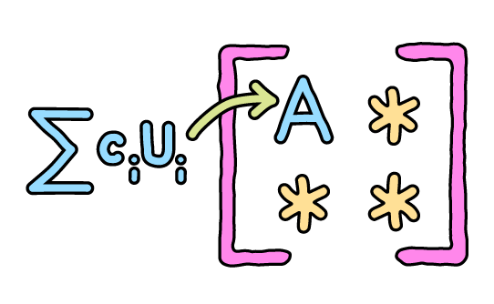
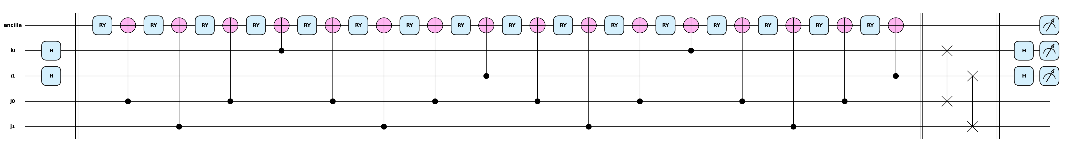
BLOCK ENCODING:
Linear Combination of Unitaries (LCU)
Matrix Access Oracles
# Matrix and Gate Decomposition generated with Pennylane
1. For N qubit window register we need N+1 ancillas to handle Block encoding. Total 2N+1 Qubits
2. Size of the Block encoded Unitary matrix would be:
(2exp(2N+1) x 2exp(2N+1))
3. Depth of circuit scales very rapidly

Slide 16
([[ 0.3333, 0.0000, 0.0000, 0.0000, …………, -0.3776, 0.1394, 0.7503], [ 0.0000, 0.3333, 0.0000, 0.0000, …………, -0.3514, 0.7863, -0.3151], [ 0.0000, 0.0000, 0.0000, 0.0000, …………, 0.0544, -0.1298, 0.2198], [0.0000, 0.0000 , 0.0000 , 0.0000, …………, 0.1570, 0.1965, 0.3183], […………, …………, ……..…,…………, …………, 0.1901, 0.1798, 0.2232], [-0.2569, -0.0261, 0.0393, 0.4411, …………, -0.6622, -0.1665, 0.1433], [ 0.0738, 0.8639, 0.0356, 0.2536, …………, 0.2981, -0.0821, 0.2532], [-0.1664, 0.3514, -0.4111, -0.4157, …………, -0.3780, -0.4900, -0.2319]],
QFT of FILTER VECTOR
2 ELEMENT FILTER VECTOR EXAMPLE
FILTER VECTOR
(32x32)
TODO: QSP and QSVT on filter vector encoded block unitary matrix
GATE PREPARATION
# Probability factor
ANCILLA QUBITS

Slide 17
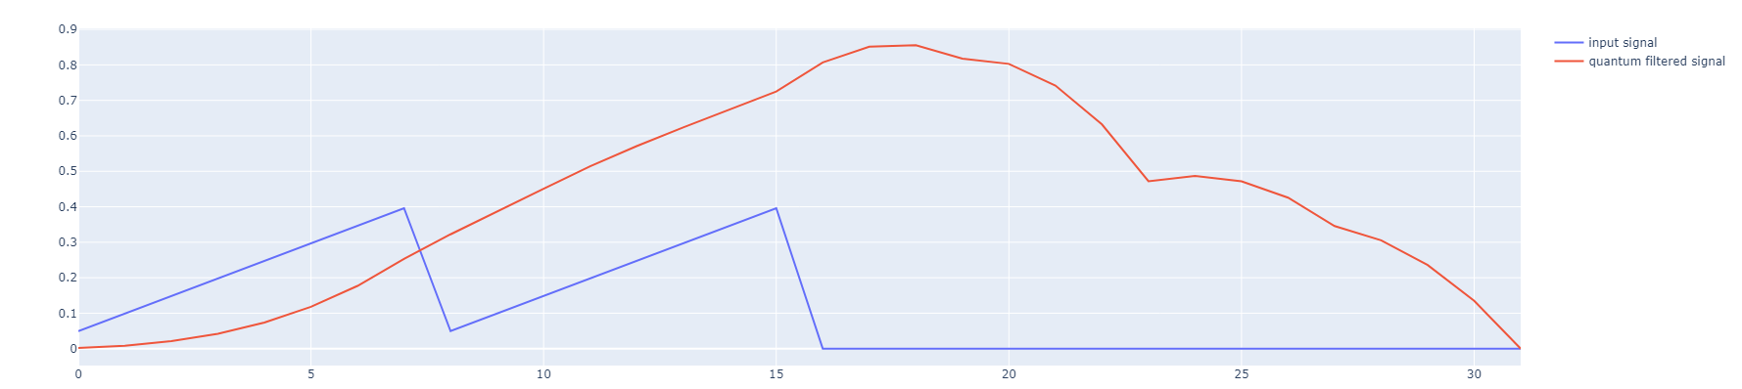
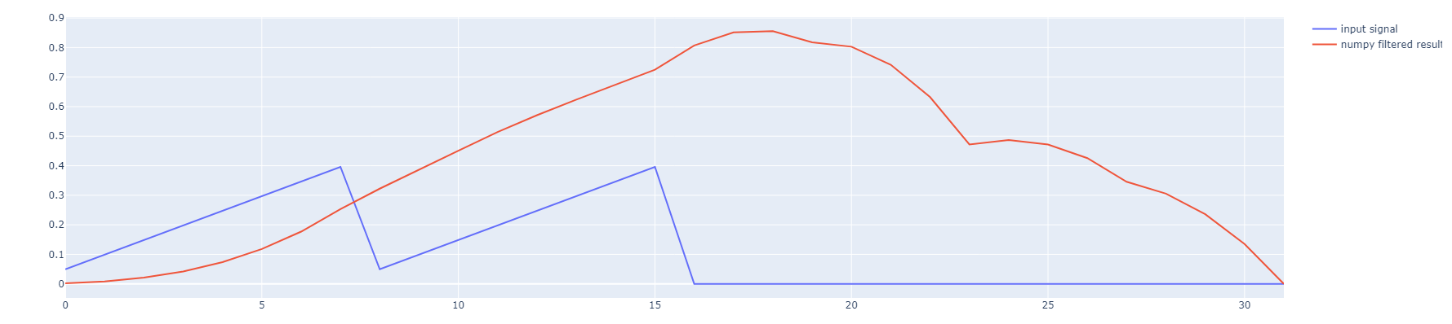
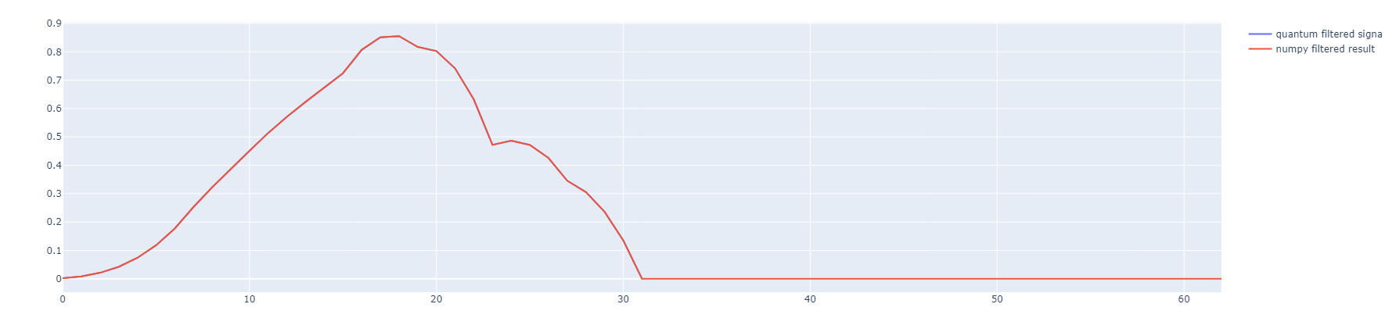
Quantum Convolution algorithm: Filter as a Unitary Gate Plots
# 16 length window/filter
# Padded to 32
# i.e. 5 Qubits
# Matrix: (2048 x 2048)
# ETA: 1.5 Hr
# PRO: We can calculate the matrix beforehand.
TODO: More Efficient Unitary PREP. (Sparse matrices, Structured matrices etc)
# Implemented with own quantum simulator

Slide 18
SUBROUTINE 3:
QUANTUM OVERLAP—ADD CIRCUIT

Slide 19
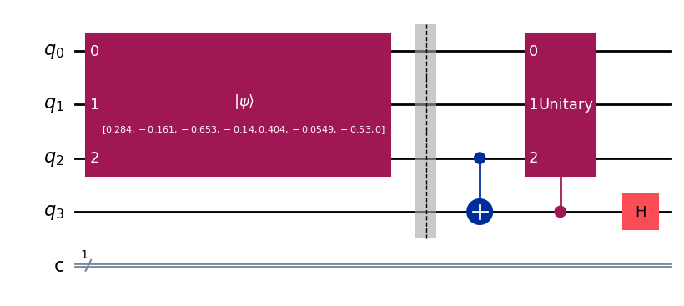
WINDOWED STATE
Quantum Overlap-Add
# Probabilistic Algorithm
QUANTUM OVERLAP ADD
ELEMENT WISE PRODUCT
FILTER
Quantum
Post-processing
QFT
# For N qubit window convolution outputs each we need total N+2 Qubits

Slide 20
Overlap-Add Circuit Example for 4 qubits
1. [a1, a2, a3, a4] [b1, b2, b3, b4]
# Two Conv o/p arrays
2. [a1, a2, a3, a4, b1, b2, b3, b4]
# Zero Padded if length not a power of 2
ENCODE
3. [a1, a2, a3, a4, b1, b2, b3, b4 ,
0, 0, 0, 0, 0, 0, 0 , 0 ]
# Ancilla introduces additional length
DIRECTION OF COMPUTATION
4. [a1, a2, a3, a4, 0, 0, 0, 0,
0, 0, 0 , 0 b1, b2, b3, b4]
SPLIT
5. [a1, a2, a3, a4, 0, 0, 0, 0,
0, 0, b1, b2, b3, b4, 0 , 0 ]
SLIDE
# Controlled Permutation matrix
ADD
6. [a1, a2, a3 + b1, a4 + b2, 0 + b3, 0 + b4, 0, 0,
a1, a2, a3 - b1, a4 - b2, 0 - b3, 0 - b4, 0, 0 ]
# SUM
Post Selection
# DIFFERENCE
When ancilla is measured as 0, we have our overlap add as the quantum state on remaining qubits:
7. [a1, a2, a3 + b1, a4 + b2, 0 + b3, 0 + b4, 0, 0]
# Probability factor of 1/sqrt(2)

Slide 21
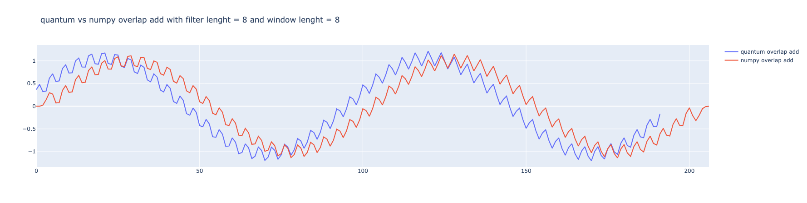
Quantum Reconstruction algorithm: Overlap-Add circuit Output
# Implemented with Qiskit

Slide 22
FULL Quantum RECONSTRUCTION ALGORITHM

Slide 23
# For N qubit window each we need total 2(2N+1) Qubits
Filter as a Register
Convolution O/P
Classical Data
Windowing
Quantum Overlap-Add
Filter as a unitary Gate
# For N qubit window each we need total 3(N+1) Qubits

Slide 24
CHALLENGES:
Need two copies for each window convolution O/P.
Different windows have different window norms.
Filter as a Register
QRAM
Convolution O/P
Windowing
Quantum Overlap-Add
Filter as a unitary Gate

